Slide 1

Topic :- Detailed Analysis on whether Jaguar Landrover should start Manufacturing in India
Team Members:-
Ajay Vishwakarma
Sumit Mathur
Ankit Vishwakarma
Hari raj
Team SAAH

Slide 2

List of Contents :
About Jaguar Land Rover
Current Scenario of JLR
Analysis about Jaguar Land-Rover Entering in Indian Market
Marketing Strategy & Marketing Mix (4Ps)
Failure Mode Effect Analysis
Profitability Framework
What could be done differently ?
Benefits In India

Slide 3
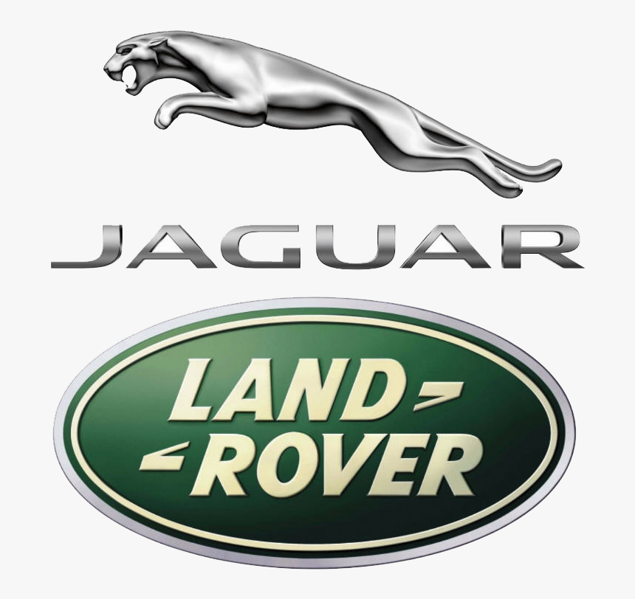
About Jaguar Land Rover:-
Introduction:
Jaguar Land-Rover is a British multinational automotive company that specializes in designing, developing, and manufacturing luxury vehicles.
The company was founded in 2008 when Tata Motors, an Indian automotive company, purchased Jaguar Cars and Land Rover from Ford.
Company Size-
The company employs almost 40,000 people globally and supports around 275,000 more through our retailers, suppliers, and local businesses.
JLR’s operating revenues range fell 7% to £18.3 billion for the financial year ending on 31 March 2022 and Its EBITDA has also fell to negative 0.4% over the previous year.

Slide 4
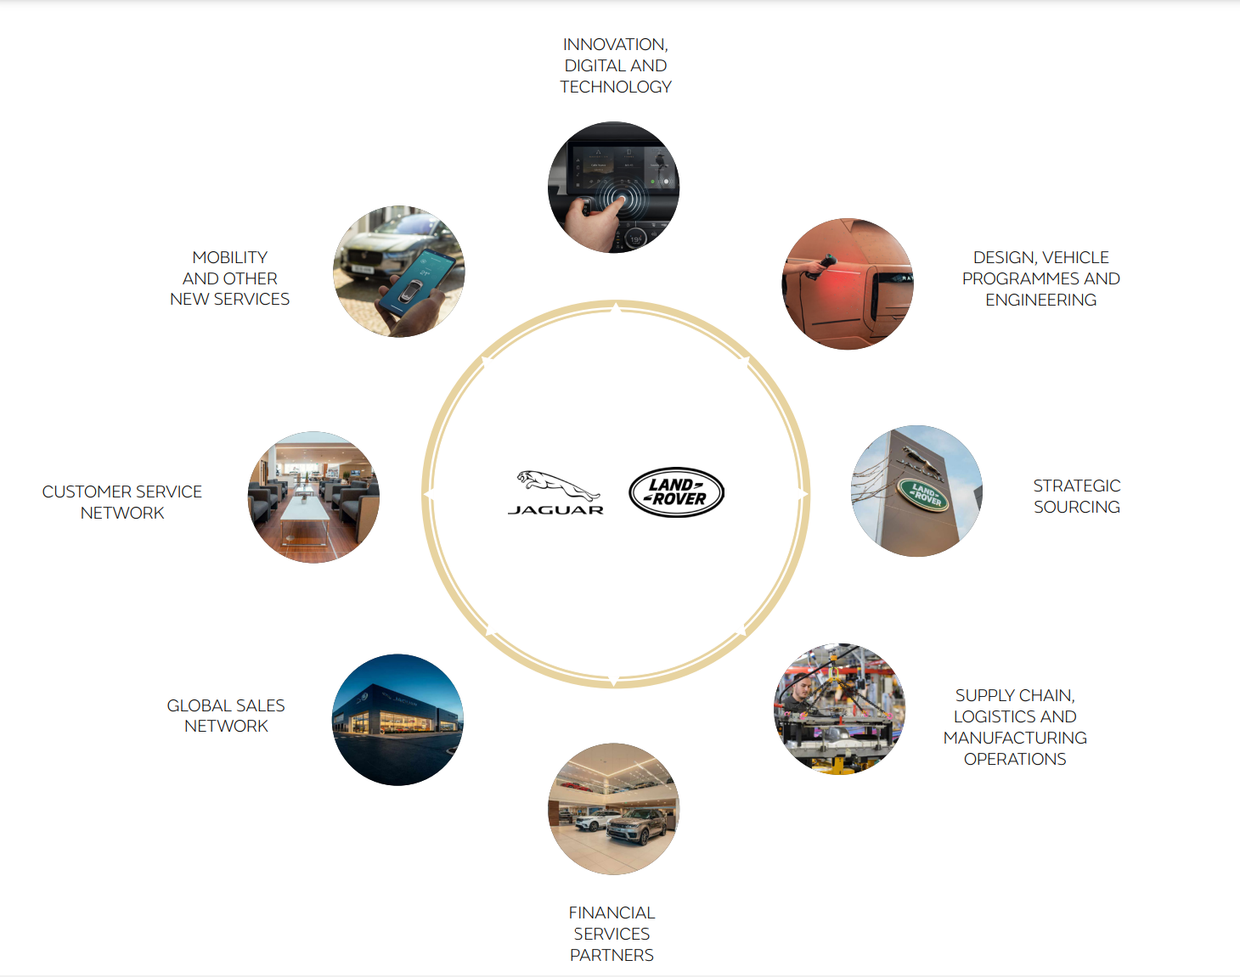
Revenue Model of JLR
About Jaguar Land Rover:-

Slide 5
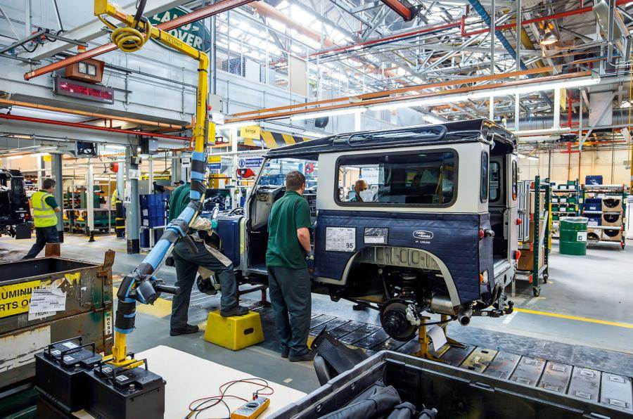
Current Scenario of JLR
Current manufacturing strategy
JLR's current manufacturing strategy is to manufacture its vehicles in the UK and export them to other countries, including India. JLR has assembly plants in China, Brazil, and Slovakia.
Global Market Presence and Market Share
Wholesales in the quarter rose by 5.7% vs Q2 and 15.0% vs the same period last year to 79,591 units with a significant increase in New Range Rover and New Range Rover Sport production . Retail sales to clients of 84,827 in the quarter .

Slide 6
Current Scenario of JLR
Market share in India
Brand | Fy-2021-22(Vlaume)
Mercedes | 11576 | 42%
BMW | 8496 | 31%
Audi | 3294 | 12%
Volvo | 1466 | 5%
Land Rover | 666 | 2%
Range Rover | 1021 | 4%
Mini | 634 | 2%
JLR | 230 | 1%
total | 27383

Slide 7
Market Size of Luxury car in India
Population of India = 140 crores
Urban-40% = 56cr Rural-60% = 84cr
In urban- In rural-
lower - 35%=14.7cr lower = 70%= 59cr
Middle -55%=23.1cr middle= 20%= 16.8cr
High-10%=4.2cr high =10%= 8.5cr
# of family can afford luxury car
Assume (rural/ high)5 members in a family = (1%)0.08/5 = 0.016(approx.)
(consider only income group)
Assume (urban/high)5 members in a family = (70%)2.94cr/5 = 0.6(approx.)
Indian market for luxury cars in India = 0.60cr(approx.)

Slide 8
Analysis about Jaguar Land-Rover Entering in Indian Market
1.Estimated Cost associated with Supplier acquisition: According to industry experts, the cost of supplier acquisition in India is generally lower than in developed countries like the UK or the US.
2. Cost associated with Setting up the plant: According to industry estimates, the cost of setting up a manufacturing plant in India can be 25-30% lower than in developed countries.
3.Cost associated with Labor acquisition: The cost would depend on various factors such as the skills and experience of the workforce, location of the plant, and the level of automation in the manufacturing process.

Slide 9
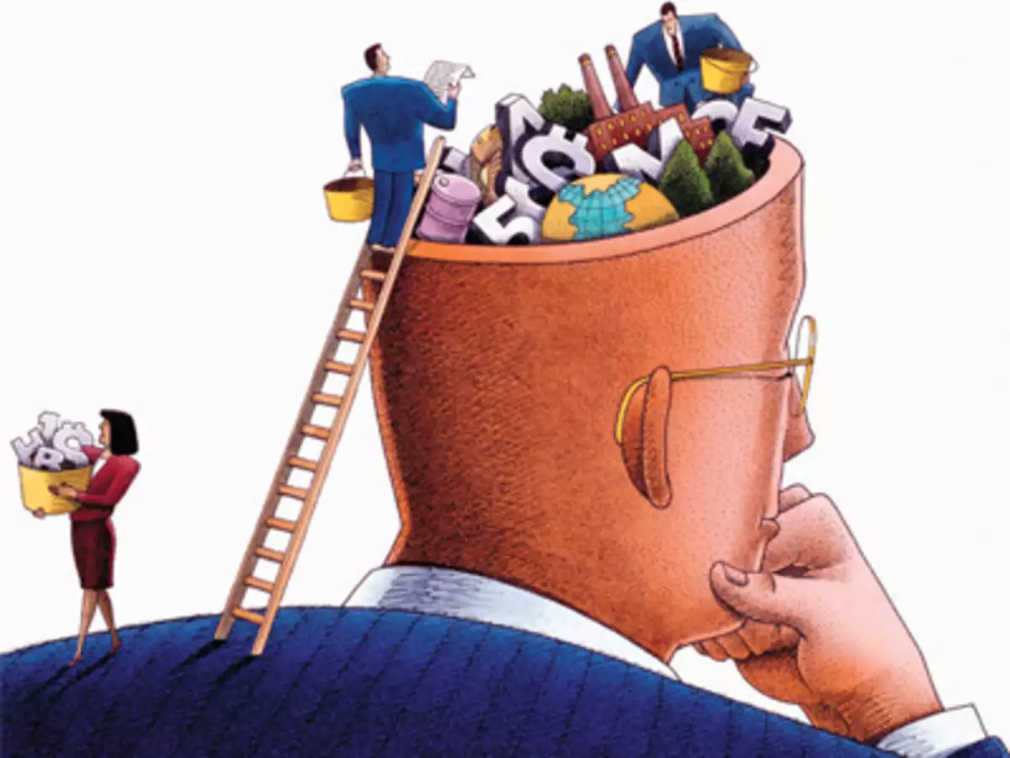
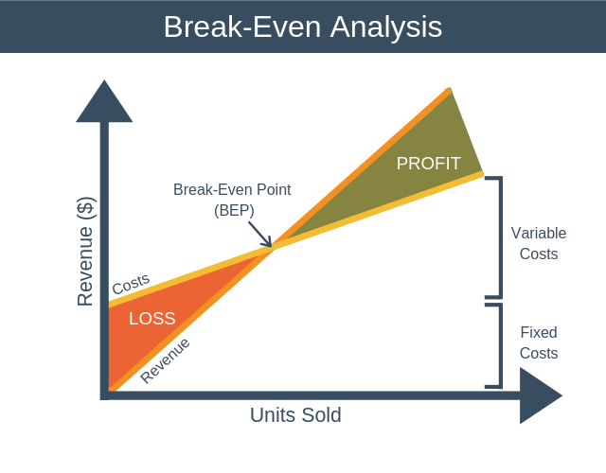
Analysis about Jaguar Land-Rover Entering in Indian Market
Socioeconomic causes: Jaguar Land Rover's entry into the Indian market could have a positive impact on the local economy by creating jobs, stimulating demand for local suppliers, and contributing to economic growth.
Estimate the Breakeven Period:The breakeven period for Jaguar Land Rover's entry into the Indian market would depend on various factors, including the cost structure, the pricing strategy, and the level of demand for its products. Based on industry estimates, the breakeven period could range from 5 to 10 years.

Slide 10
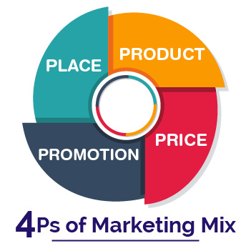
Marketing Strategy & Marketing Mix (4Ps)
PRODUCT :- Land Rover's product strategy focuses mainly on luxury, comfort, and speed, which gives it a tough competition in the market. It continuously comes up with new and innovative products that appeal to affluent customers.
PRICE :- Land Rover SUV pricing varies according to demography, different markets, different products and location. This helps in covering a larger number of customers who can access their vehicle according to their comfort
PLACE :- Land Rover has built up a channel which consists of various international network and more than 2000 franchise sales dealers, As now Land Rover has been purchased by Tata Motors which is an Indian company so Land Rover is focusing on its further expansion in Asia
PROMOTION :- Land Rover is one of the company who doesn’t need a very big promotion but still Land Rover lot of its effort to keep up with the brand name and make up an image of adventure spirits in the mind of customers,

Slide 11
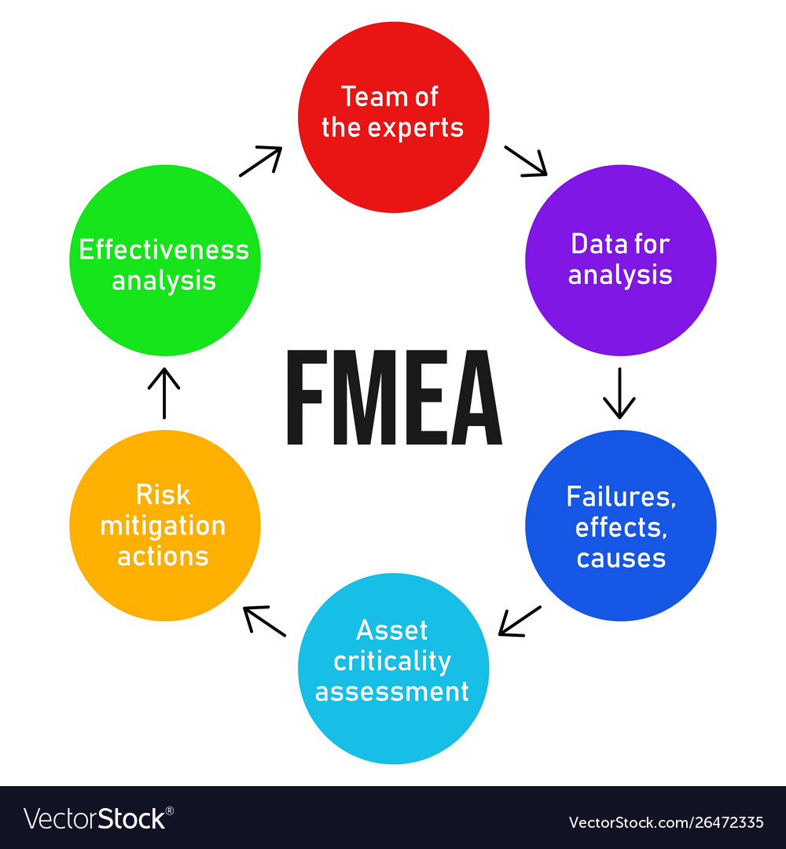
Failure Mode Effect Analysis
Jaguar will face several challenges if they start manufacturing cars in India, including quality control, supply chain disruptions, labor and workforce challenges, regulatory compliance, competition, less units will be sold according to market penetration, and infrastructure challenges. However, these challenges can be overcome with careful planning, investment, and collaboration with local partners.

Slide 12
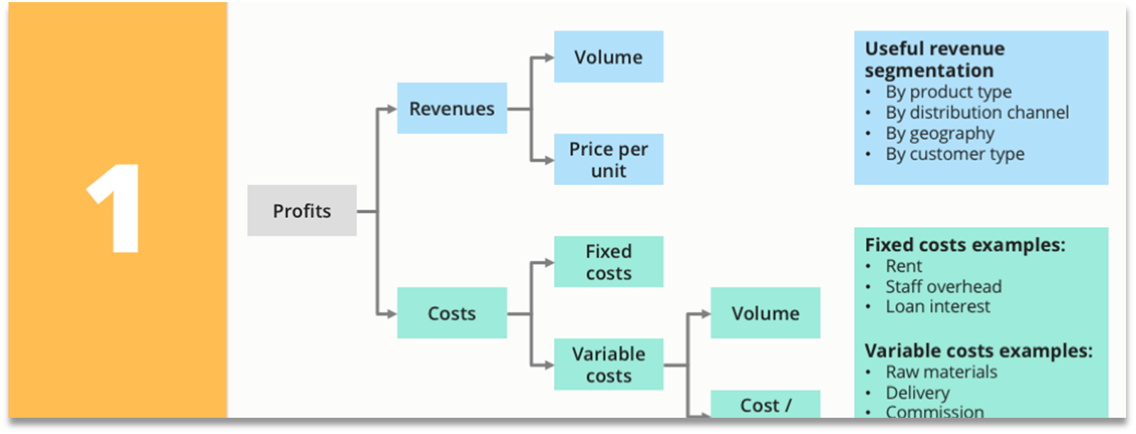


Profitability Framework

Slide 13

What could be done differently ?
Identify key suppliers in India and negotiate cost-effective contracts for outsourcing certain components of the manufacturing process.
Establish a new manufacturing plant in India that focuses on producing high-volume vehicles for the domestic and export markets.
Outsourcing some of the manufacturing processes could be a cost-effective way to enter the Indian market without investing in a new plant.
Our Car cost as compared to other luxury brands is high e.g. – BMW, Mercedes, and Audi our cost should be comparable.

Slide 14
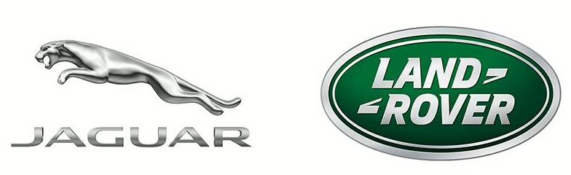
Benefits In India
Implement efficient supply chain management systems that minimize costs and maximize efficiency.
Develop a comprehensive marketing and sales strategy to promote Jaguar Land-Rover vehicles in the Indian market and increase market share.
By outsourcing some components of the manufacturing process and setting up a new plant in India, Jaguar Land-Rover can take advantage of the lower labor costs and access to a new customer base while maintaining control over the quality of its products.

Slide 15


Slide 16


